Slide 1

Baseball Dataset
BY STRYDER R. COLEMAN, PADRAIC DARBY, CHESTERAN HOLLIGAN, AND SHYAN WALKER
Notes:
Shyan: Introduction to Baseball DataBank

Slide 2

Introduction
For this project, we used a database off of Kaggle named Baseball Databank which contained various baseball statistics ranging from 1871-2015.
We also modified the contents of the dataset to answer a range of questions related to baseball.
Notes:
The stats were made by mlb staticians

Slide 3
Baseball Databank
(The Original Files Compared to The Files that were used for the project)
AllStarFull.csv
AwardsManagers.csv
AwardsPlayers.csv
AwardsShareManagers.csv
AwardsSharePlayers.csv
Batting.csv
BattingPost.csv
Fielding.csv
FieldingOF.csv
HallOfFame.csv
Managers.csv
ManagersHalf.csv
Master.csv
Pitching.csv
PitchingPost.csv
Salaries.csv
SeriesPost.csv
Teams.csv
TeamsFranchises.csv
TeamsHalf.csv
AwardsPlayers.csv
Batting.csv
BattingPost.csv
Fielding.csv
Master.csv
Pitching.csv
PitchingPost.csv
Salaries.csv
Notes:
the data frames we selected are important to player performance

Slide 4
Data frames:
AwardsPlayers:
playerID chr, awardID chr, yearID num, lgID chr, tie logic, notes chr
Foreign Key(playerID, yearID)
Batting:
playerID num, yearID num, stint num, teamID chr, lgID chr, G num, AB num, R num, H num, 2B num, 3B num, HR num, RBI num, SB num, CS num, BB num, SO num, IBB num, HBP num, SH num
Foreign Key(playerID, yearID)
BattingPost:
yearID num, round chr, playerID chr, teamID chr, lgID chr, G num, AB num, R num, H num, 2B num, 3B num, HR num, RBI num, SB num, CS num, BB num, SO num, IBB num, HBP num, SH num, SF num, GIPD num
Foreign Key(playerID, yearID)
Fielding:
playerID chr, yearID num, stint num, teamID chr, lgID logic, POS chr, G num, PO num, A num, E num, DP num, PB num
Foreign Key(playerID, yearID)
Master:
playerID chr, birthYear num, birthMonth num, birthDay num, birthCountry chr, birthState chr, birthCity chr, deathYear num, deathMonth num, deathDay num, deathCountry chr, deathState chr, deathCity chr, nameFirst chr, nameLast chr, nameGiven chr, weight num, height num, bats chr, throws chr, debut date, finalGame date, RetroID chr, bbrefID chr
Foreign Key(playerID)
Pitching:
playerID chr, yearID num, W num, L num, G num, GS num, CG nnum, SHO num, SV num, IPouts num, H num, ER num, HR num, BB num, SO num, BAOpp num, ERA num, WP num, HBP num, BK num, BFP num, GF num, R num
Foreign Key(playerID, yearID)
PitchingPost:
playerID chr, yearID num, round chr, teamID chr, lgID chr, W num, L num, G num, GS num, CG num, SHO num, SV num, IPouts num, H num, HR num, BB num, SO num, BAOpp num, ERA num, IBB num, WP num, HBP num, BK num, BFP num, GF num, R num, SH num, SF num, GIDP num
Foreign Key(playerID, yearID)
Salaries:
yearID num, teamID chr, lgID chr, playerID chr, salary num
Foreign Key(playerID, yearID)
Notes:
Chesteran: Data frames to Data Frames Cont.
**Foreign Key connects data frames to each other
**Briefly Discuss Each Dataframe

Slide 5
Data frames(cont):
(Data from all the data sets excluding Master were filtered from 1995 onwards)
(Data from Master was filtered by filtering all players whose final appearance was prior to the 1995 MLB season)
Prior to filtering: Post filtering:
AwardsPlayers: 6,078 AwardsPlayers: 1521
Batting: 101,332 Batting: 28,477
BattingPost: 11,690 BattingPost: 6,005
Fielding: 170,526 Fielding: 50,317
Pitching: 44,139 Pitching: 14,309
PitchingPost: 5109 PitchingPost: 2958
Master: 18,846 Master: 5,464
Salaries: 25,575 Salaries: 18,158
Total: 383,295 Total: 127,209
Notes:
**We only wanted modern baseball statistics
** older statistics include baseball stats prior to desegregation (Which would have split the best players across multiple leagues)
and the game is completely different now

Slide 6
Combining data frames
In baseball a player can play for multiple teams in a single season. To get accurate seasonal data we needed to combine all of their data
Postseason data was also divided by series (level in playoffs). Hence we combined a players postseason observations into a single row.
Notes:
Stryder: Removing Variables to Creating Statistics
most statistics were summed together. However, for ERA we needed to recalculate it to get accurate results

Slide 7
Joining Data Frames
Since many of are variables were separated into different data frames we used joins
For Player_WAR we used a full join to get every observation into the newly created data frame
For AwardedSalaries we used a left join
For Pitcher_Stats we used a left join
We used a Join in at least 7 other cases

Slide 8
Questions

Slide 9

Can we predict the number of runs a player will score over a season?
Notes:
Stryder:11-13

Slide 10
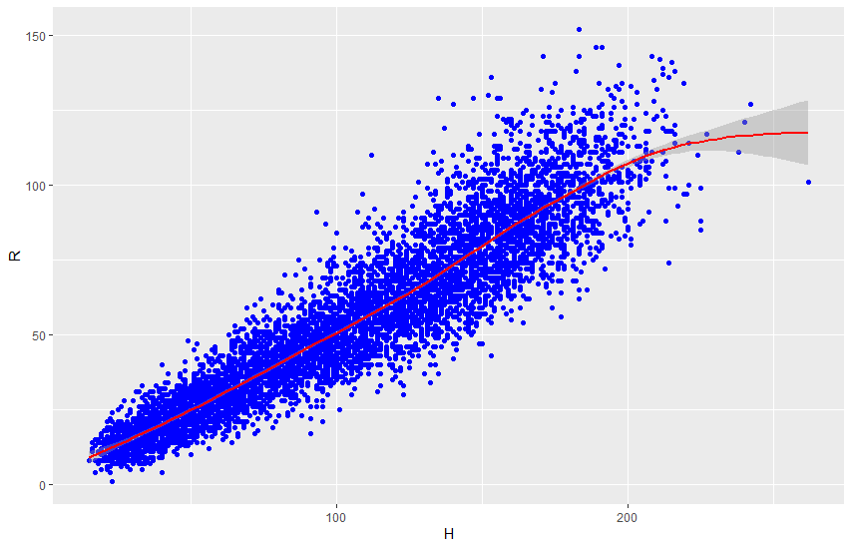
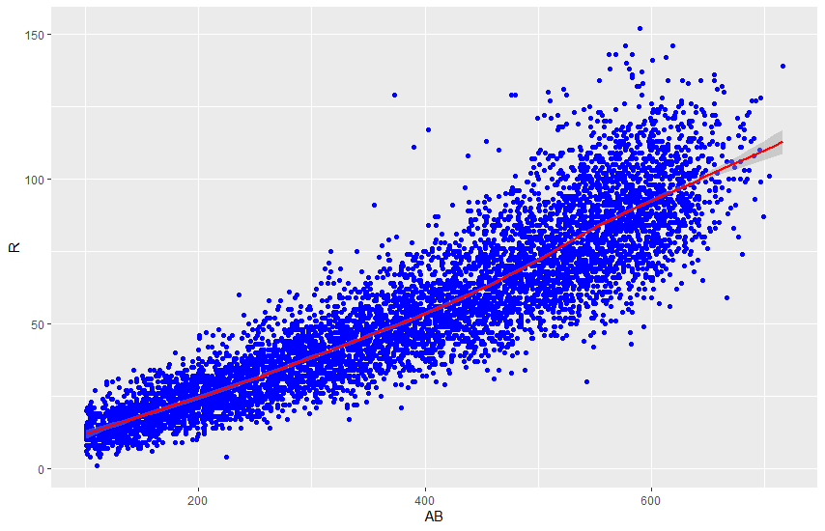
Distribution of runs over a season

Slide 11
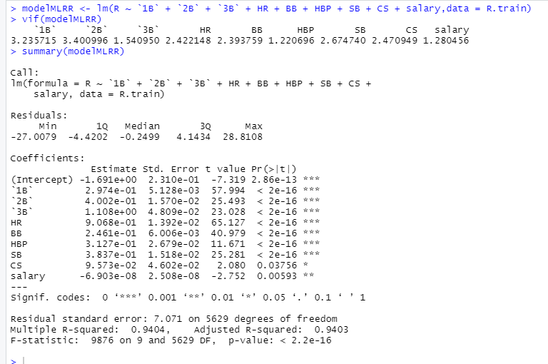
Predicting Runs (R)
Model Type | R² | RMSE
MLR | 0.9403 | 7.064734
SVR | 0.9504799 | 6.197216
DT | 0.8246219 | 12.08289
Notes:
There are many ways for a player to score a lot of runs

Slide 12

Predicting Position Player’s Performance?
Single Season Hit Record Holder Ichiro Suzuki (2001)
Notes:
Padraic: Predicting Position Player’s Performance (14) to Best Model For FIP (23)
WAR - Wins Above Replacement is a measure of a players overall impact on a game and deciphers how many wins he is worth over a replacement-level Player (an unsigned free agent)
the higher the WAR correlates to the better player

Slide 13
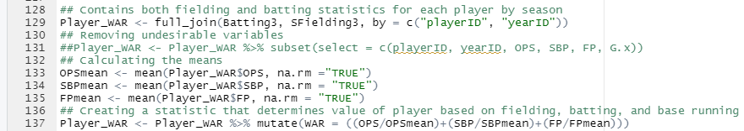
WAR formula
WAR = (OPS/OPSmean)+(SBP/SBPmean)+(FP/FPmean)
Notes:
For a position player baserunning, fielding, and batting is the three major areas of play
Therefore WAR consist of a baserunning metric stolen base percentage (SBP), a fielding metric fielding percentage (FP), and a batting metric On base percentage plus slugging; which measure a players ability to get on base + their ability to hit for power
we divide the state OPS, SBP, and FP by the average OPS, SBP, and FP. to determine where each player falls based on the average
We added them up to get a single statistic that rates an individual players performance in all major areas of play.
We didn’t have the correct attributes to calculate the official war used by the mlb; so We made our own WAR statistic

Slide 14
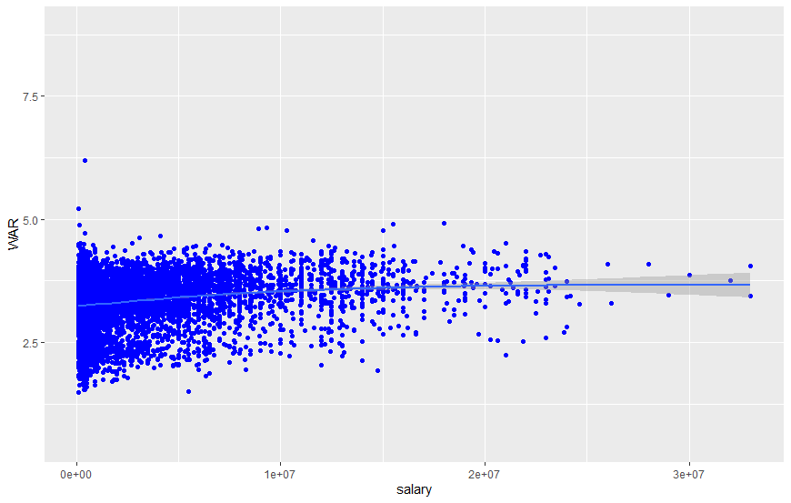
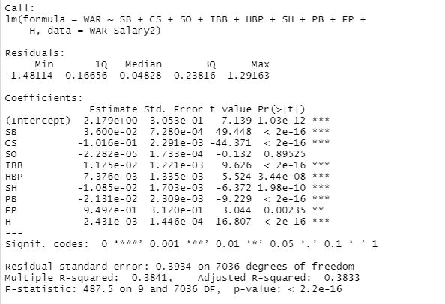
Is salary a good predictor for Player performance(WAR)?
Visualization
MLR
Notes:
**Player WAR converges towards a best fit line which means there is less variability the higher the salary for position players
We have determined that salary alone is not a reliable predictor for the WAR of the player

Slide 15
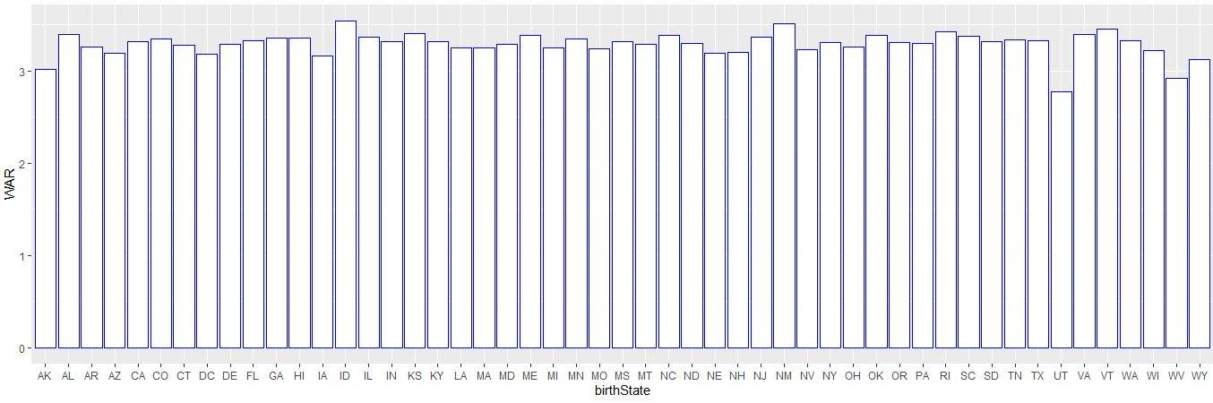
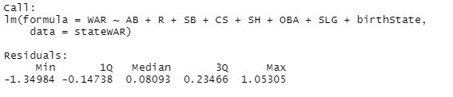

Does birth location play a role in player Performance(WAR)?
Visualization
MLR
Notes:
There is not a noticeable difference in the WAR of players averaged by the States that they were born in
We have determined that the birth State alone is not a reliable predictor for the WAR of the player

Slide 16
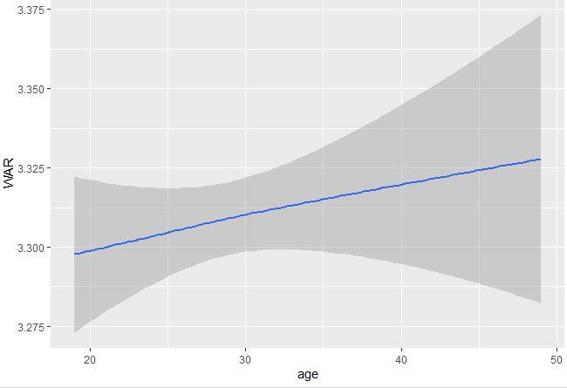
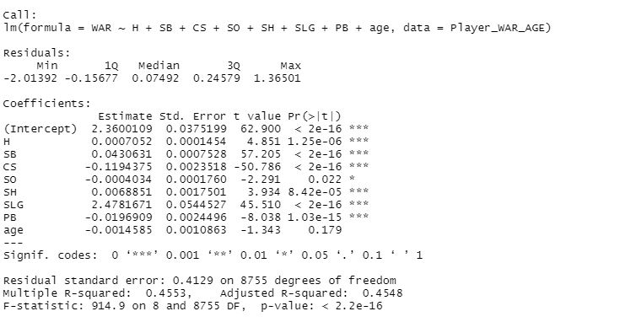
Is age a factor in performance(WAR)?
Visualization
MLR
Notes:
There is a slight positive correlation with the WAR and age. which means that players are at their worst when first making it to the MLB and gradually get better as they get age.
We have determined that the age alone is not a reliable predictor for the WAR of the player

Slide 17

Predicting Performance of Pitchers
On September 24, 2010, against the San Diego Padres, Chapman was clocked at 105.1 mph
Notes:
FIP - Fielding Independent Pitching is a state which rates a pitchers overall performance on a scale in which possessing a lower number means that your a better player
Whats unique about the FIP is that is rates the performance of pitchers regardless of the Defense

Slide 18
FIP Formula
FIP = ((13*HR)+(3*(BB+HBP))-(2*SO))/IP + FIPconstant
FIPconstant = lgERA - (((13*lgHR)+(3*(lgBB+lgHBP))-(2*lgSO))/lgIP)
Notes:
the lgStats are those particular statistics averaged over the course of the season for all players in the MLB

Slide 19
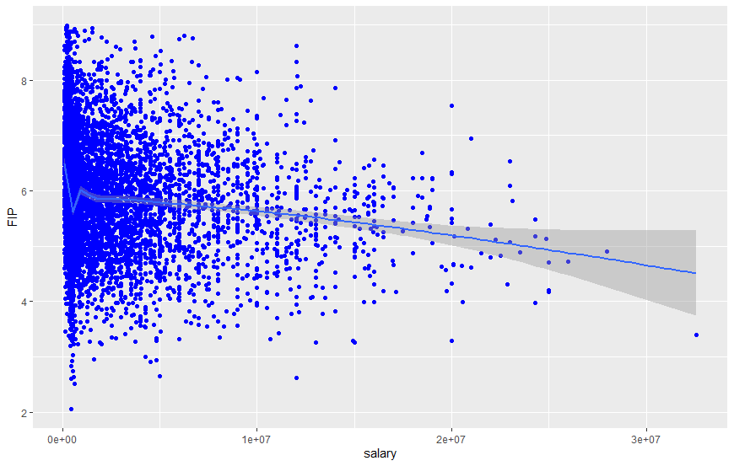
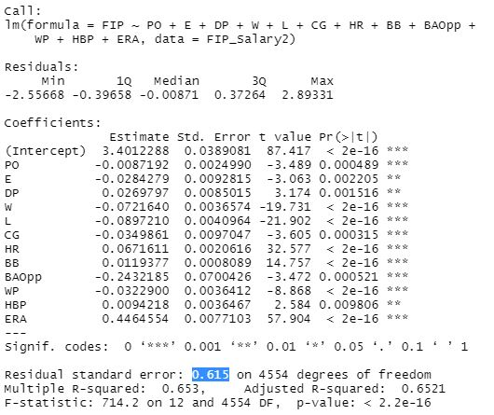
Performance(FIP) Vs Salary
Visualization
MLR
Notes:
**Player FIP converges towards a best fit line which means there is less variability the higher the salary for Pitchers
We have determined that salary alone is not a reliable predictor for the FIP of the player

Slide 20
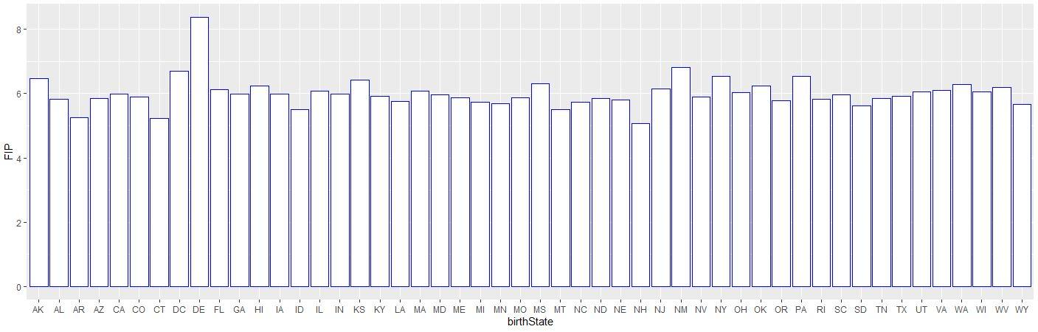
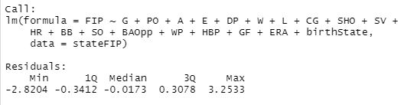

Performance(FIP) Vs. Birth Location
Visualization
MLR
Notes:
outside of Delaware, Washington DC, Alaska, and New Mexico which have abnormally high FIP values
there is little variation in the average performance of pitchers by their birth state.
We have determined that Birth Location alone is not a reliable predictor for the FIP of the player

Slide 21
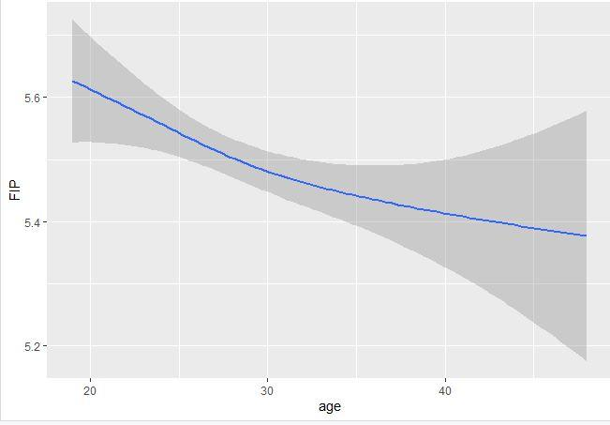
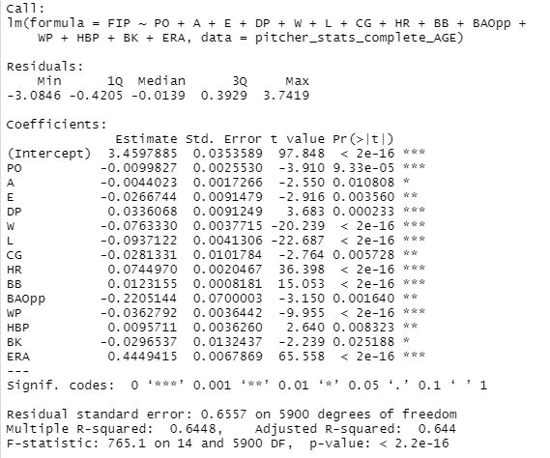
Performance(FIP) Vs Age
Visualization
Model
Notes:
There is a slight negative correlation with the FIP and age. however since the lower FIP indicates a better player this means that pitchers gradually get better with age.
We have determined that age alone is not a reliable predictor for the FIP of the player

Slide 22
What are the flaws in tradition statistics?
Notes:
Stryder:11-13

Slide 23
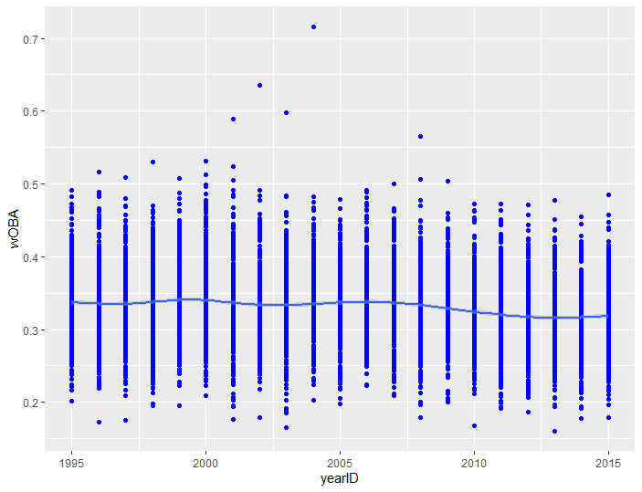
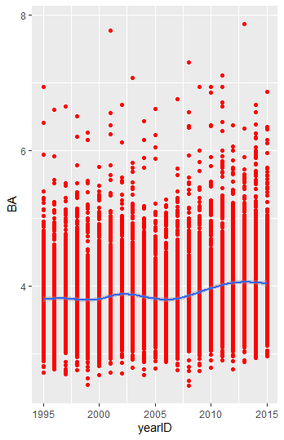

Slide 24
Linear Regression
Call:
lm(formula = Batting$wOBA ~ Batting$BA, data = Batting)
Residuals:
Min 1Q Median 3Q Max
-0.082899 -0.023075 -0.002766 0.019678 0.313097
Coefficients:
Estimate Std. Error t value Pr(>|t|)
(Intercept) 0.5796545 0.0023652 245.1 <2e-16 ***
Batting$BA -0.0640404 0.0006024 -106.3 <2e-16 ***
---
Signif. codes: 0 ‘***’ 0.001 ‘**’ 0.01 ‘*’ 0.05 ‘.’ 0.1 ‘ ’ 1
Residual standard error: 0.03273 on 9154 degrees of freedom
Multiple R-squared: 0.5525, Adjusted R-squared: 0.5524
F-statistic: 1.13e+04 on 1 and 9154 DF, p-value: < 2.2e-16

Slide 25
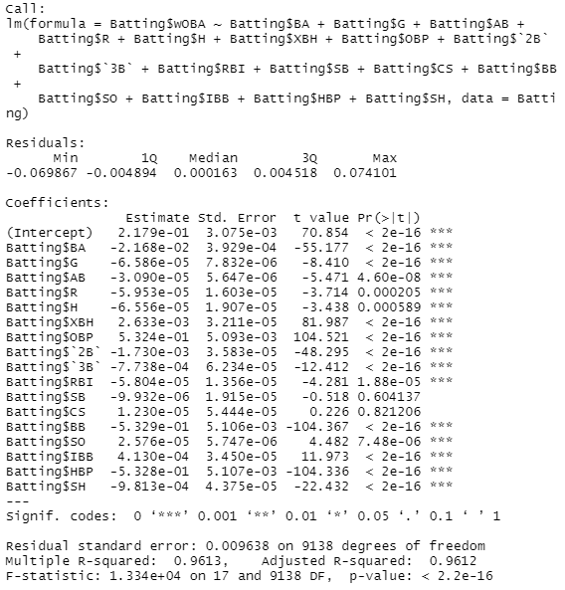
Multiple Linear Regression
Batting$BA Batting$G Batting$AB Batting$R Batting$H
4.906423e+00 8.721483e+00 8.518724e+01 2.132135e+01 8.983013e+01
Batting$XBH Batting$OBP Batting$`2B` Batting$`3B` Batting$RBI
4.040108e+01 1.640488e+06 1.547865e+01 1.979037e+00 1.629528e+01
Batting$SB Batting$CS Batting$BB Batting$SO Batting$IBB
3.085947e+00 2.659344e+00 1.441157e+06 4.041019e+00 1.971237e+00
Batting$HBP Batting$SH
3.431376e+04 1.512586e+00

Slide 26
SVR
training.s <- Batting$wOBA %>% createDataPartition(p = 0.8, list = FALSE)
> train.data <- Batting[training.s, ]
> test.data <- Batting[-training.s, ]
> SVM_wOBA <- svm(wOBA ~ BA + `2B` + `3B` + H + AB + RBI + SO + IBB + XBH + OBP + BB + SH + HBP + SB + CS , data = Batting)
> predicted.classes <- SVM_wOBA %>% predict(test.data)
> head(predicted.classes)
1 2 3 4 5 6
0.3620805 0.3666271 0.3637814 0.2384761 0.4601797 0.3013924
> mean(predicted.classes == test.data$wOBA)
[1] 0
> rmse(Batting$wOBA, predicted.classes)
[1] 0.0686932
1 2 3 4 5 6
3.636986 3.711325 3.333475 3.657702 3.312752 4.260222
> mean(predicted2.classes == test.data2$BA)
[1] 0
> rmse(Batting$BA, predicted2.classes)
[1] 0.7709805
Notes:
There are many ways for a player to score a lot of runs

Slide 27
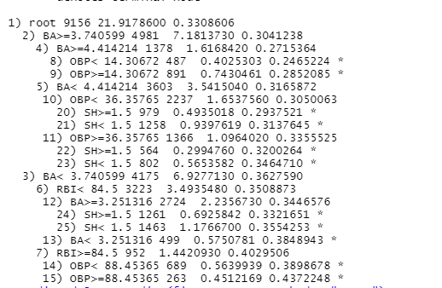
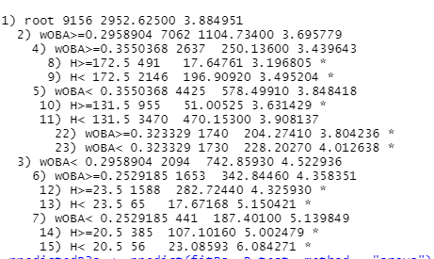
wOBA RSME = 0.06413
OBA RSME= 0.7297271

Slide 28
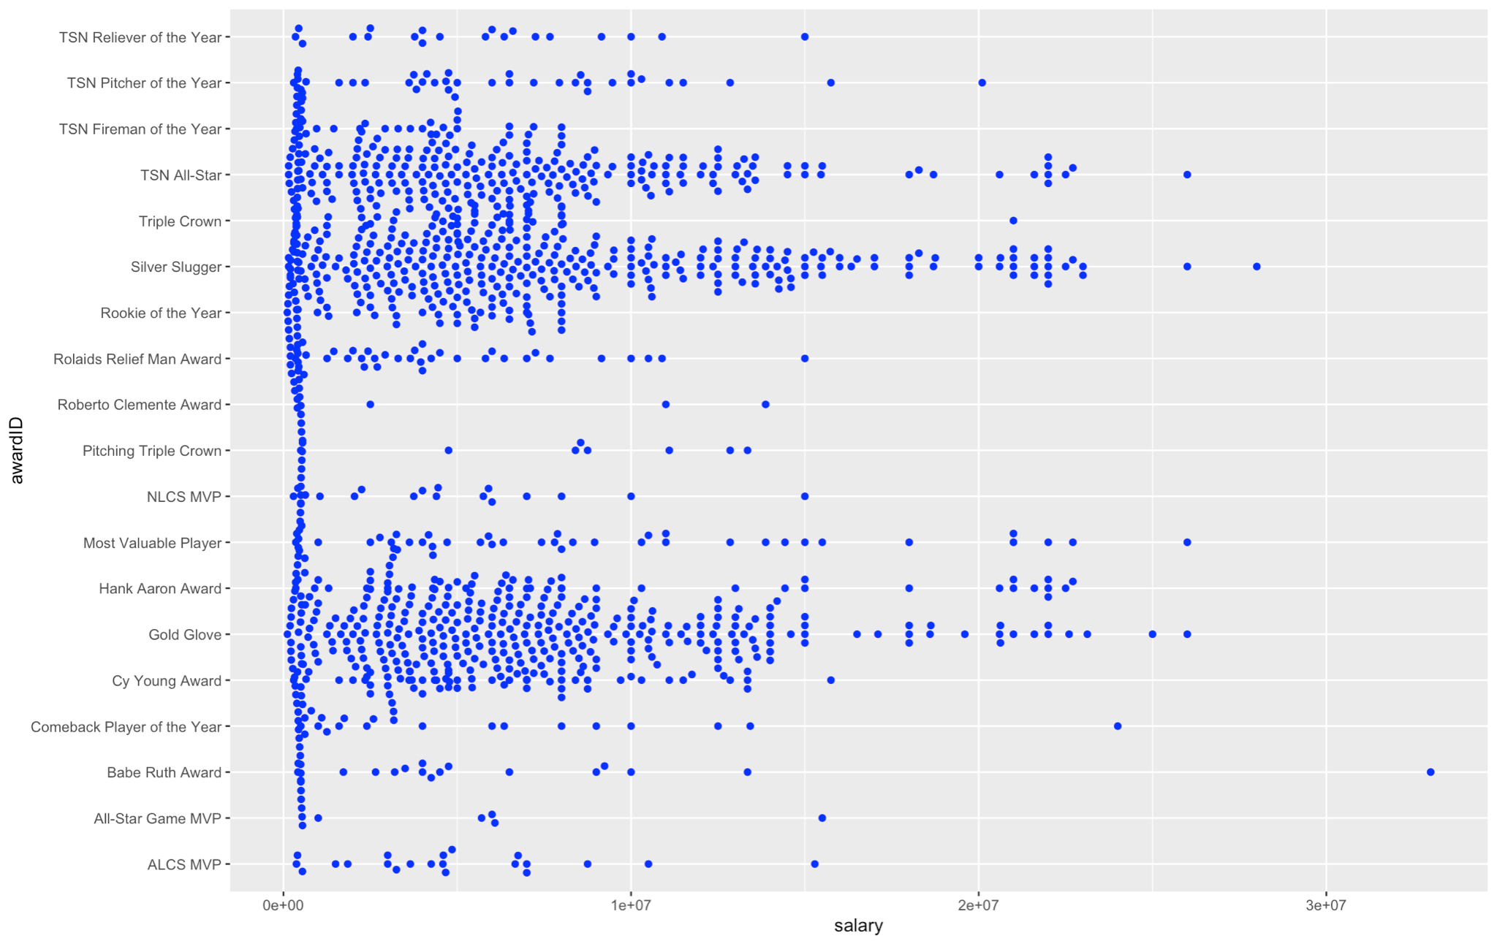
Is Salary
an
indicator
of Awards
won?
Notes:
Chesteran: Awards
1.310 * 10^13

Slide 29
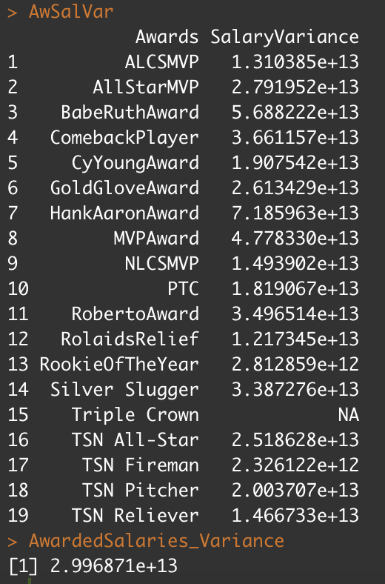

Slide 30

Predicting Earned Runs
Notes:
Stryder: Predicting Runs to Predicting Earned Runs

Slide 31
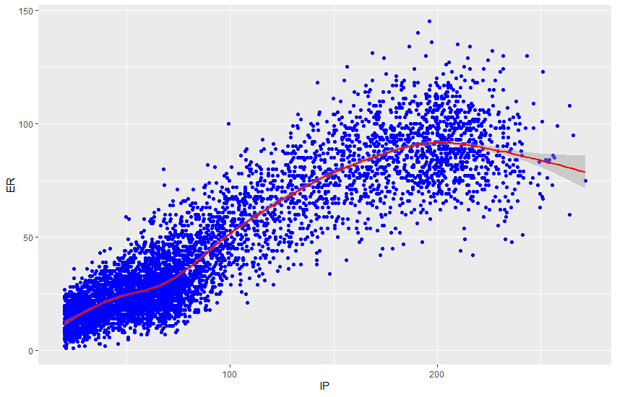
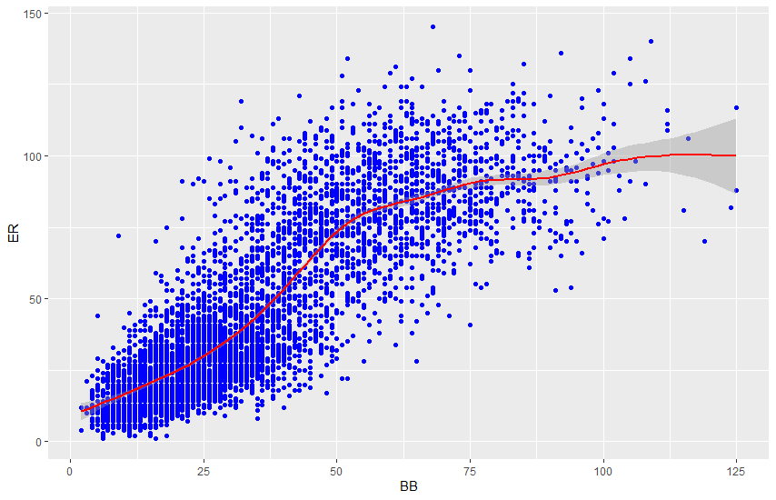
Distribution of Earned Runs(ER)
**visualization for ER

Slide 32
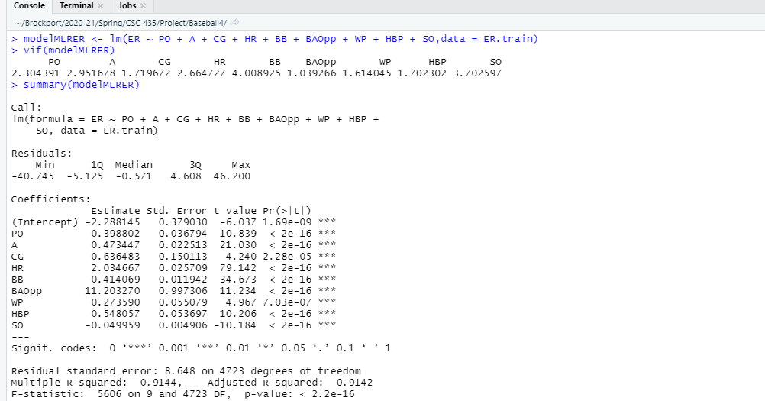
Predicting Earned Runs (ER)
MLR
Model Type | R² | RMSE
MLR | 0.9142 | 7.971095
SVR | 0.965072 | 6.179019
DT | 0.8518378 | 11.24423

Slide 33
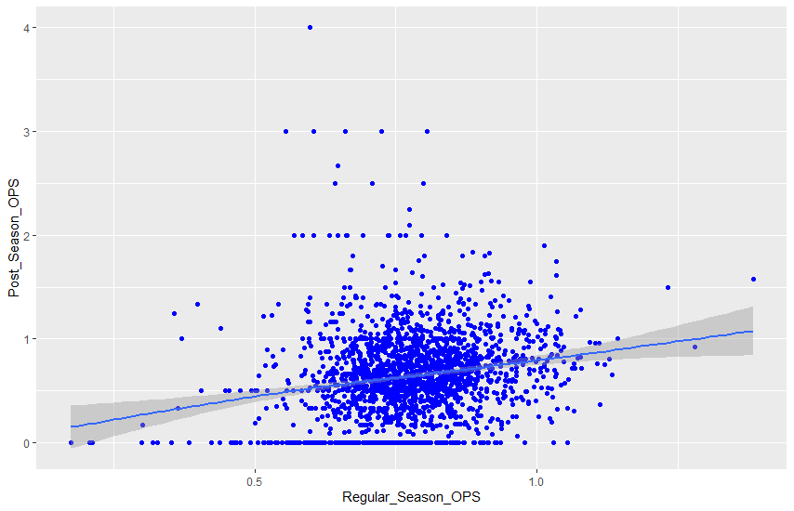
What is the relationship between regular season and postseason performance?
Conclusion
There is a slight positive correlation
Unfortunately postseason performance is difficult to predict using regular season statistics
Notes:
Postseason performance needs to be further investigation. It seems that postseason history could be used as a predictor. However, that method will be flawed too.

Slide 34

Questions?

